Slide 1

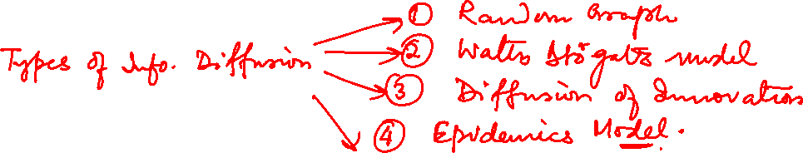
Graph Theory and its Applications
Epidemics model
Dr. Arti Arya
Department of Computer Science
and Engineering

Slide 2

Graph Theory and its Applications
Introducing Epidemics model
Dr. Arti Arya
Department of Computer Science and Engineering

Slide 3
Graph Theory and its Applications Acknowledgement
The course slides are prepared by Prof. BhaskarJyoti. But various additional inputs are added by me from various reliable resources from Foreign and Indian Universities as well as from sites.
Notes:
Ok. Having said that, lets get back to what we were speaking about.
Input devices. We have seen that the virtual reality eco system largely encompasses three fundamental components that include
HMD – head mounted devices that give you immersive VR experience, we saw some examples in the last class like the HTC VIVE, Oculus Rift, Samsung gear and so on. Some of you have also used few of these and experienced it for a few minutes.
And the second components is the GTD or the Gesture Tracking Devices. We saw a video of Xsense IMU sensors that can accurately estimation the position and orientation of a dancer. we will in the next hour see how these gesture tracking devices work and what are the various technicalities that go into tracking. I will try to keep it as non-mathematical as possible, as the mathematics behind it can get pretty messy and complicated. However, if you are interested in the mathematical aspects, I will be more than happy to discuss.
On the screen you can see that a 3 directional coordinate system is depicted. The 3 primary axes of a 3d coordinate system is X, Y and Z axis. Hear I would like to know where, when and why in your past have you encountered 3 dimensional coordinate system.
Give some time to the students to ponder on
Ok, if I tell you, I have encountered 2 dimension in images, drawings, sketch and so on. While I have encountered 1 dimension when I want to know the temperature currently or current time or something like that. Similar, where and when have you encountered 3D, either consciously or subconsciously.
Explain the roll pitch and yaw concepts.
Degree of freedom

Slide 4
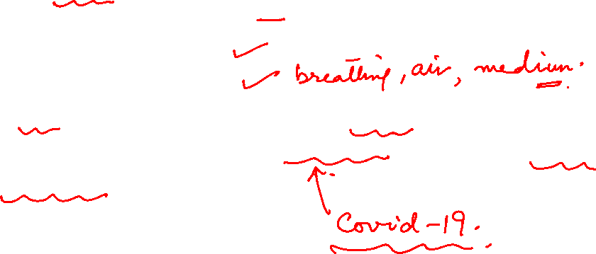
NETWORK ANALYSIS AND MINING
What is an epidemic ?
An epidemic consists of
A pathogen or a disease
A population of hosts
A spreading mechanism
Epidemics are typically across a country. Large multi country epidemics are called pandemics whereas endemic is location specific.

Slide 5
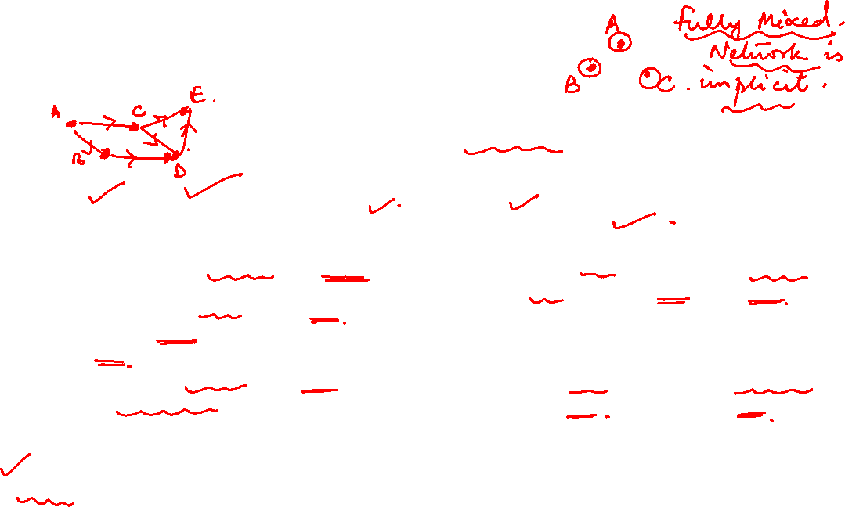
NETWORK ANALYSIS AND MINING
Two approaches for epidemic modeling
Two Approaches for Epidemic Modeling
Contact Network Model
Fully Mixed Model( Mean Field )
Considers the underlying social network structure of a population.
It assumes that individuals interact with each other and can transmit the disease along their connections.
These models can capture the effects of network structure on disease spread, such as the presence of highly connected individuals (known as "hubs") and the formation of clusters of infected individuals.
HIV/AIDS : edges represent sexual interactions.
Assumes each host has an equal chance of meeting other hosts regardless of their social n/w connections
Assumes implicit networks and unknown connections and this makes models more suitable for global patterns and not in who infected whom!
Treats the population as a homogeneous group and do not account for the effects of network structure on disease spread.
Used for modeling large populations where individual connections are difficult to track or for simulating the behavior of a disease in a hypothetical, idealized population.

Slide 6
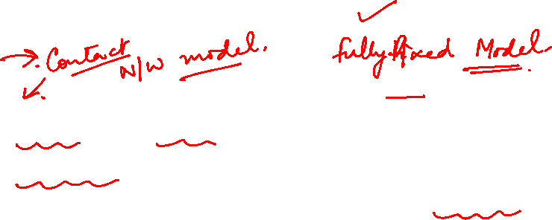
NETWORK ANALYSIS AND MINING
Example : Ebola & HIV
HIV
Less lethal than Ebola
Not fast spreading
First appeared in the 70s
Initially confined in special groups: homosexual men, drug users, prostitutes
Eventually escaped to the entire population
Ebola
First emerged in Zaire 1976 (now Democratic Republic of Kongo)
Very fast spread
Very lethal: it can kill somebody within a few days
A small outbreak in 2000
From 10/2000 – 01/2009, 173 people died in African villages

Slide 7
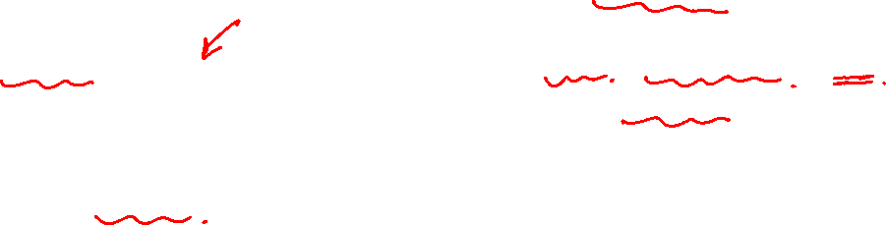
NETWORK ANALYSIS AND MINING
Example – Melissa computer worm, Hotmail viral marketing
Melissa
Started on March 1999
Infected MS Outlook users
Very fast spreading
The user
Receives email with a word document with a virus
Once opened, the virus sends itself to the first 50 users in the outlook address book
First detected on Friday, March 26
By Monday infected >100K computers
Viral Marketing: Hotmail.com
Very fast spreading
Jul 1996: Hotmail.com started service
Aug 1996: 20K subscribers
Dec 1996: 100K
Jan 1997: 1 million
Jul 1998: 12 million
Bought by Microsoft for $400 million
Marketing: At the end of each email sent there was a message to subscribe to Hotmail.com “Get your free email at Hotmail"

Slide 8
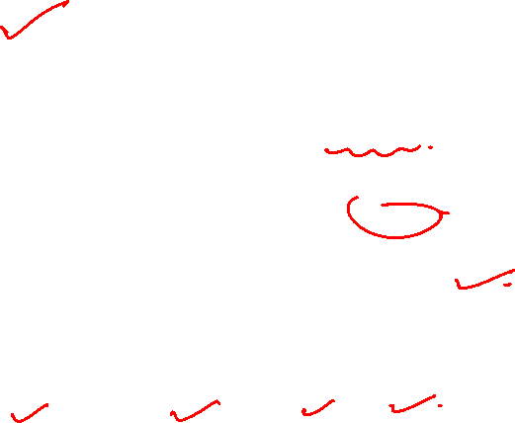
NETWORK ANALYSIS AND MINING
Recap

Slide 9
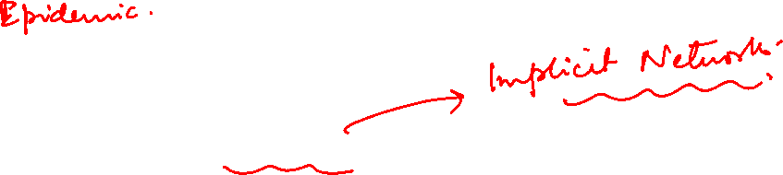
Comparing
Unlike herding
Similar to diffusion of innovations models,
Epidemic models assume an implicit network and unknown connections between individuals.
Macro level model : This makes epidemic models more suitable when we are interested in global patterns, such as trends and ratios of people getting infected, and not in who infects whom.

Slide 10
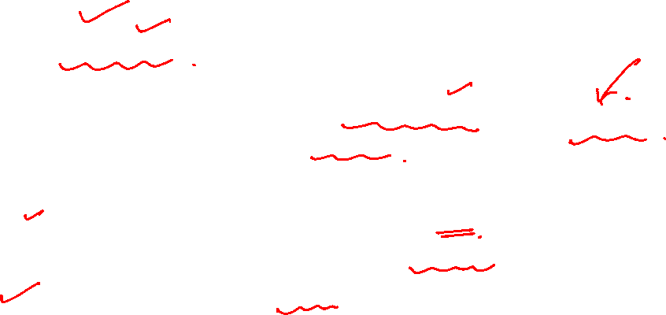
Epidemics model basics
Model epidemic spread as a random process (probabilistic) on the graph and study its properties
Questions that we can answer:
What is the projected growth of the infected population?
Will the epidemic take over most of the network?
How can we contain the epidemic spread?
What is skipped ?
These models are expressed in the form of differential equations. Solving these equations are not discussed

Slide 11
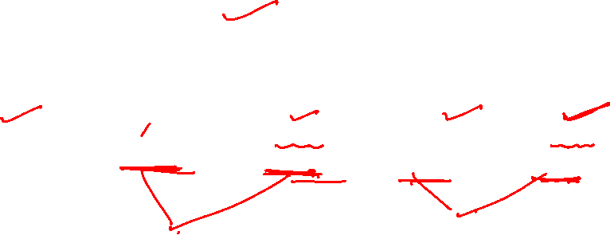
Different Models
Epidemic Models
Branching Model
SI Model
SIR Model
SIS Model
SIRS Model

Slide 12
Branching model

Slide 13
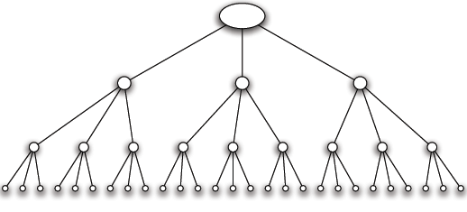
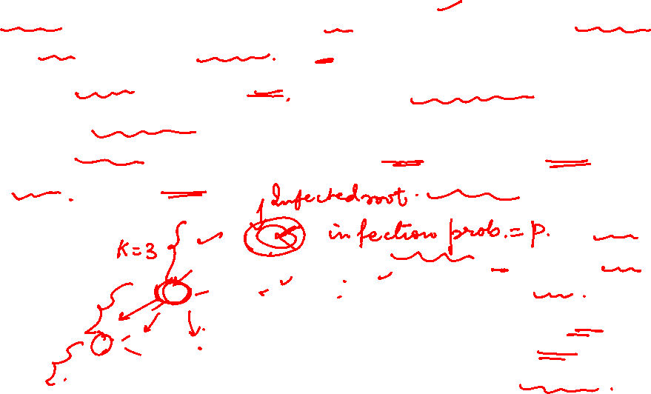
Branching model
Branching process: A person transmits the disease to each people he/she meets independently with a probability p ( infection probability)
An infected person meets k (new) people while he/she is contagious
Infection proceeds in waves.
There is a first wave ( a person carrying an infection enters a network and he infects few). Then there is a second wave and subsequent waves.
Contact network is a tree with branching factor k.
The tree shows the people contacted by infected root

Slide 14
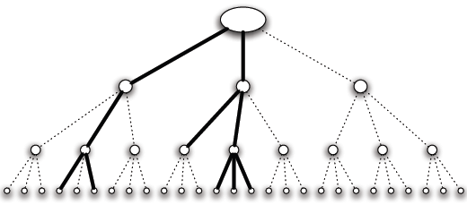
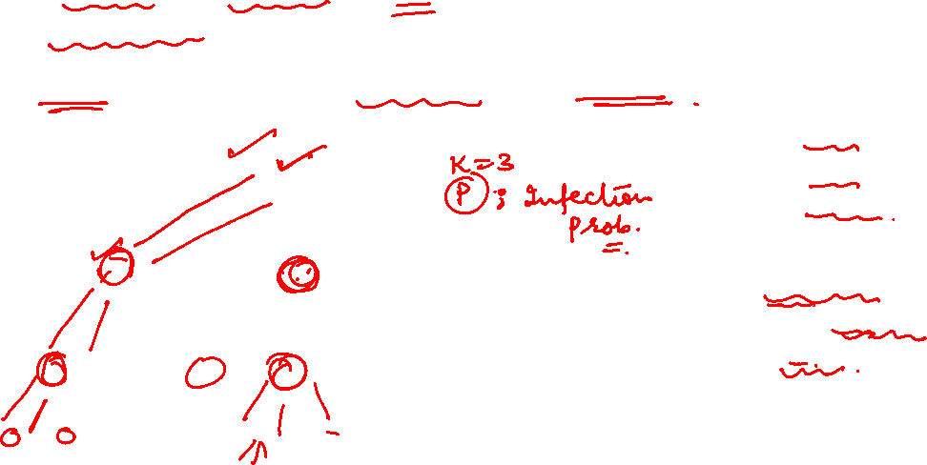
Infection spread in branching model
We’ll look for
in the number of people infected (spread)
the duration of the infection
This depends on the infection probability p and the branching factor k
An aggressive epidemic with high infection probability
The epidemic survives after three steps

Slide 15
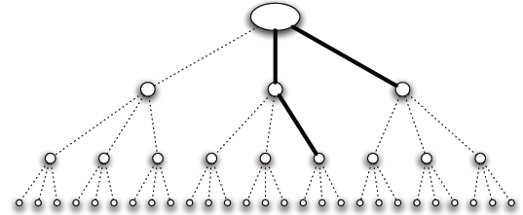
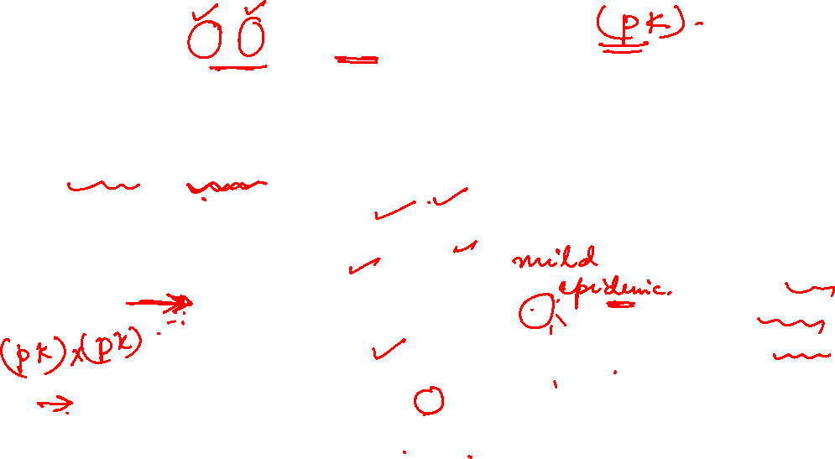
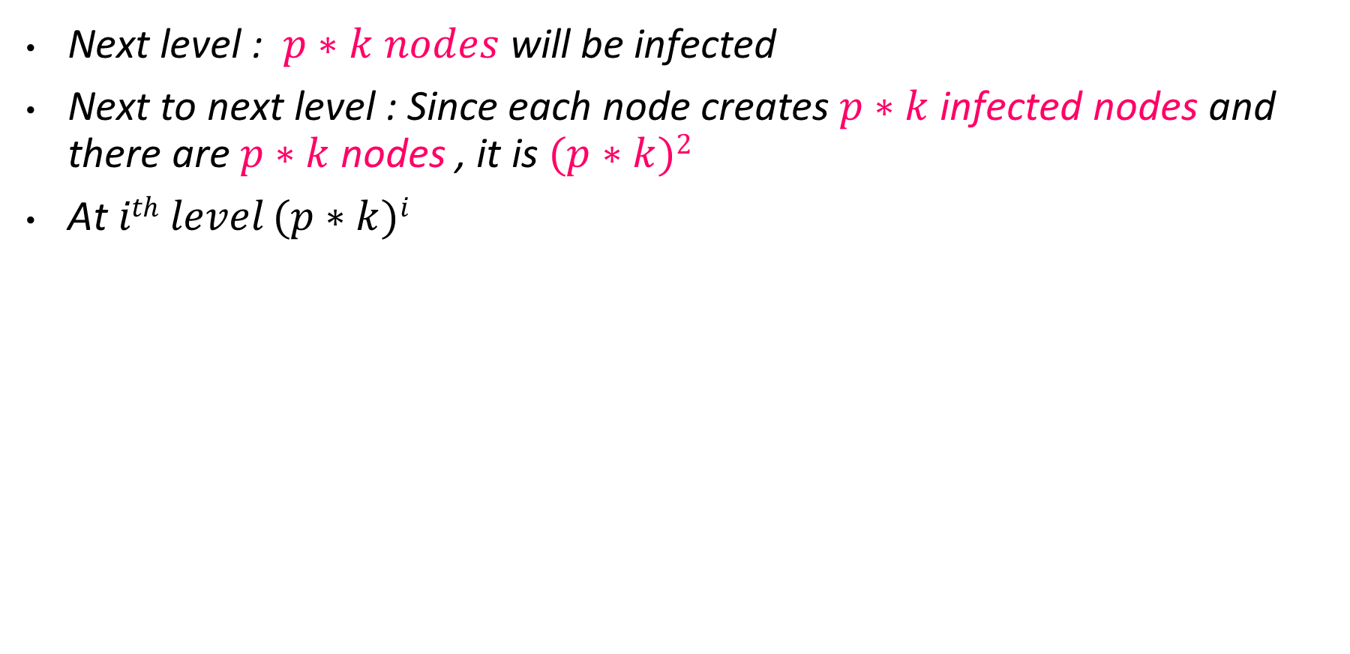
Infection spread in branching model
Next level : $p∗k nodes$ will be infected
Next to next level : Since each node creates $p∗k$ infected nodes and there are $p∗k$ nodes , it is $(p∗k)2$
At $ith level (p∗k)i$
A mild epidemic with low infection probability
The epidemic dies out after two steps

Slide 16
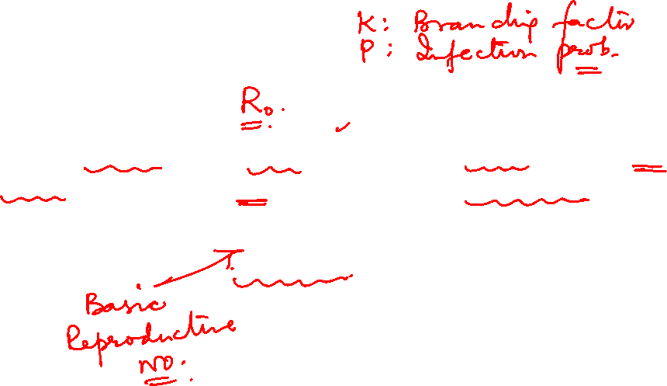
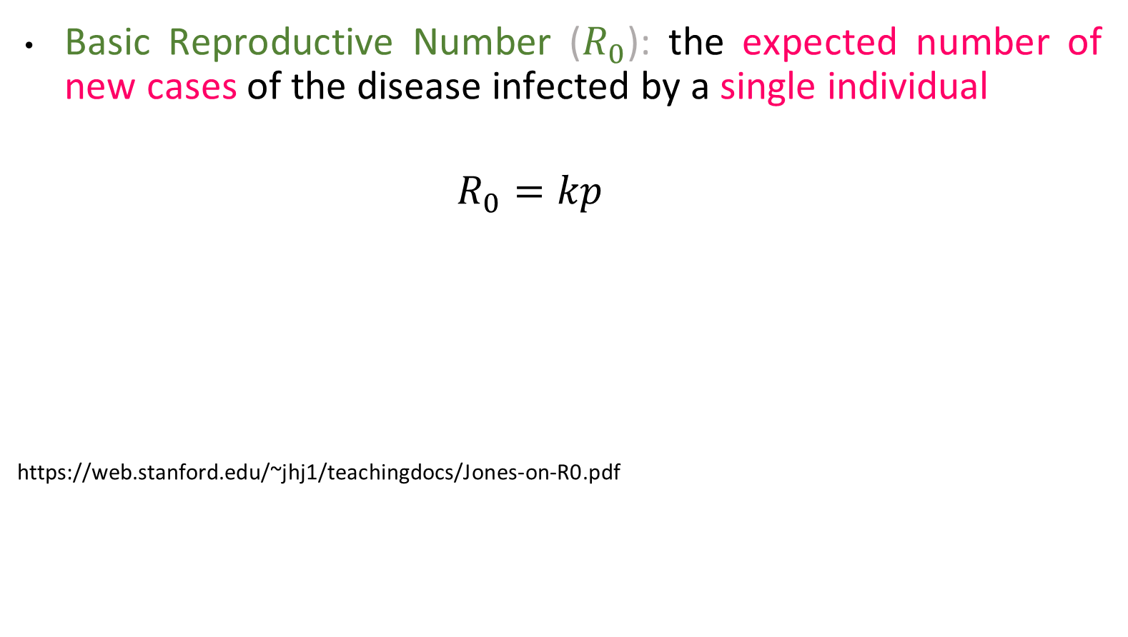
Basic Reproductive Number
Basic Reproductive Number ($R_{0}$): the expected number of new cases of the disease infected by a single individual
$$R_{0}=kp$$
https://web.stanford.edu/~jhj1/teachingdocs/Jones-on-R0.pdf

Slide 17
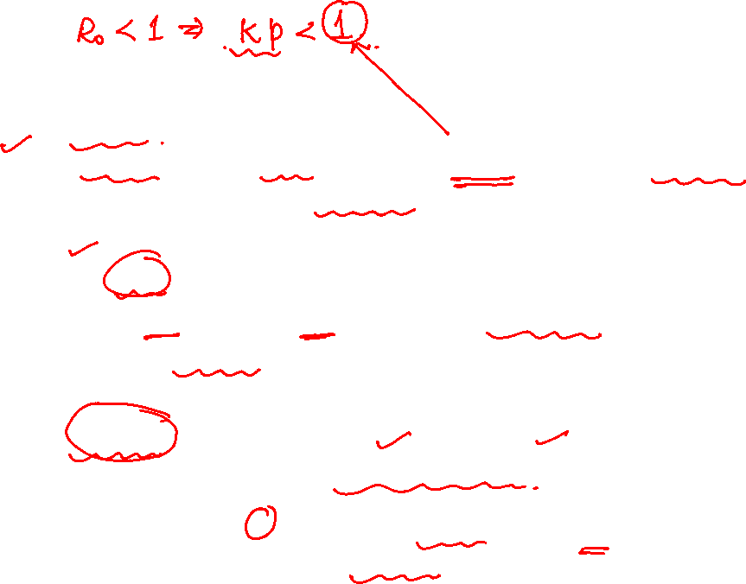
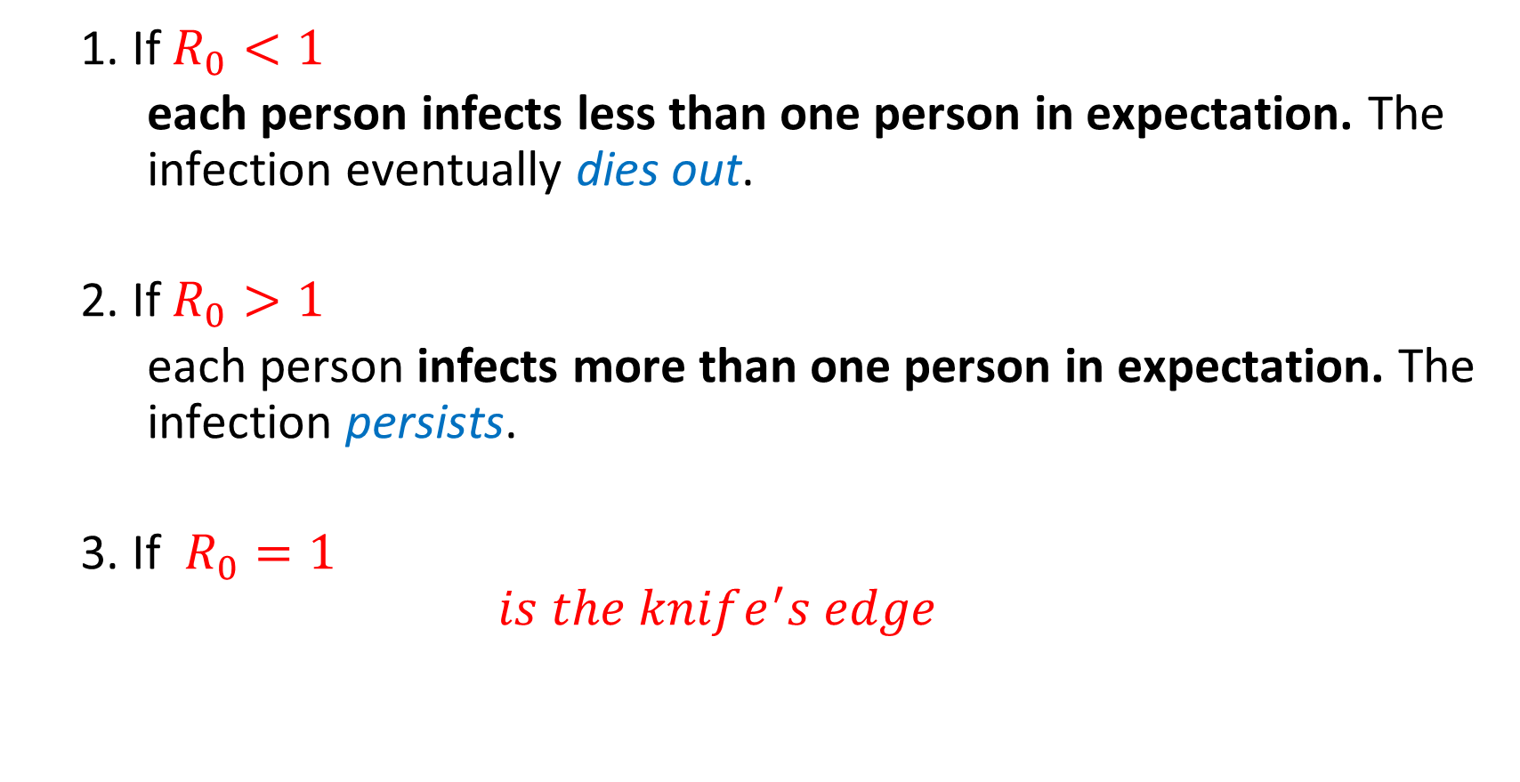
Basic Reproductive Number
1. If $R_{0}<1$
each person infects less than one person in expectation. The infection eventually dies out.
2. If $R_{0}>1$
each person infects more than one person in expectation. The infection persists.
3. If $R_{0}=1$
$$is the knife^{′}s edge$$
Reduce k or p ( either you disinfect the infected person (p) or confine him (k) !)

Slide 18
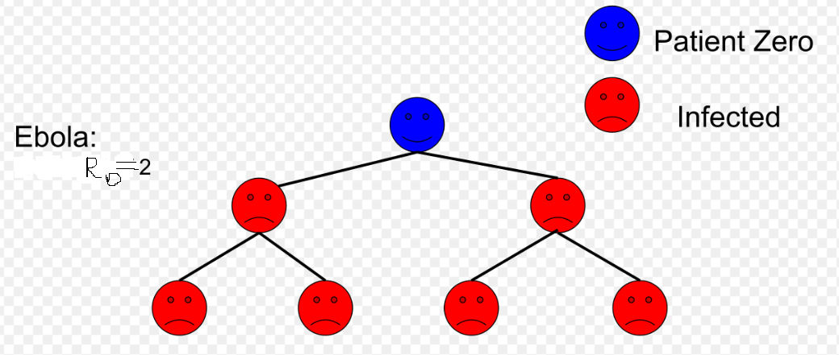
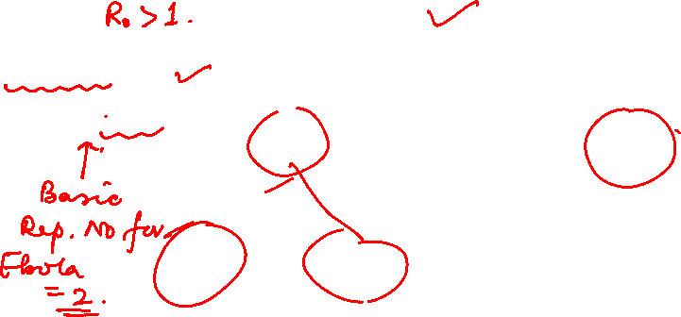
Basic Reproductive Number

Slide 19
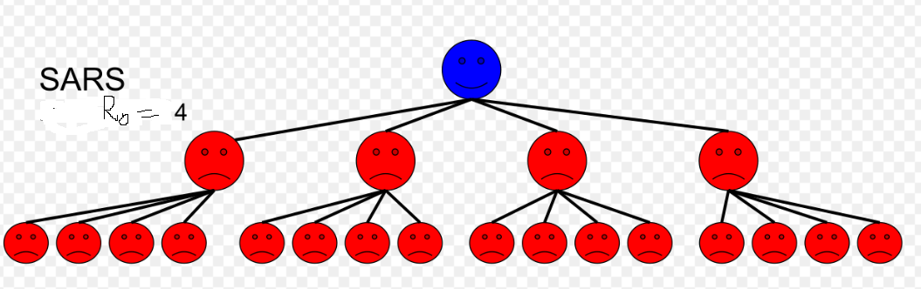
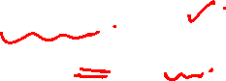
Basic Reproductive Number

Slide 20
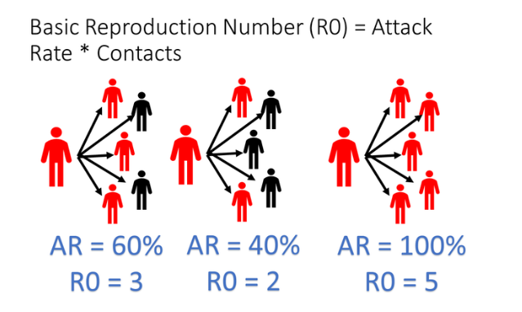
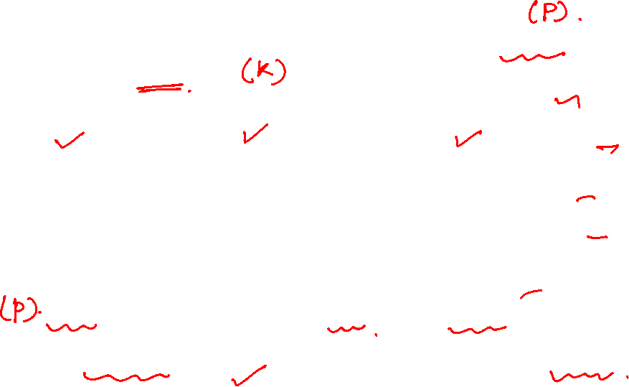
Basic Reproductive Number
https://www.methodsman.com/blog/understanding-the-numbers-behind-covid-19

Slide 21

NETWORK ANALYSIS AND MINING
Knife edge
The dichotomy expressed by this condition(R₀ > 1) has an interesting “knife-edge” quality to it when R₀ is close to 1.
Consider a branching process where R₀ is very slightly below 1, and increase the contagion(infection) probability p by a little bit; the result could push R₀ above 1, suddenly resulting in a positive probability of an enormous outbreak.
The same effect can happen in the reverse direction as well, where slightly reducing the contagiousness of a disease to push R₀ below 1 can eliminate the risk of a large epidemic.

Slide 22
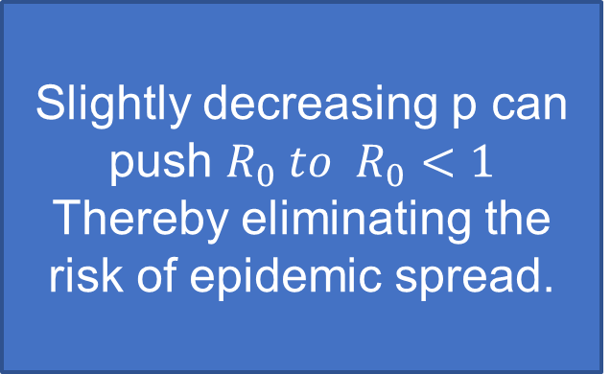
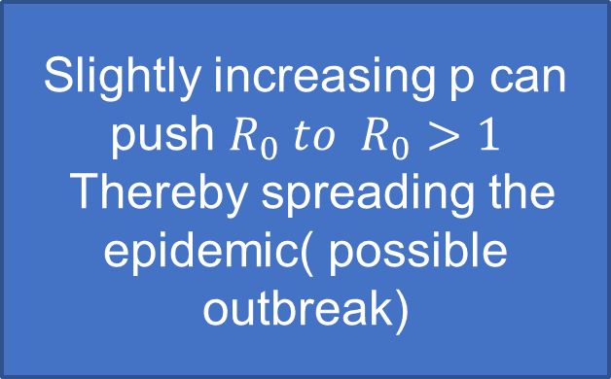

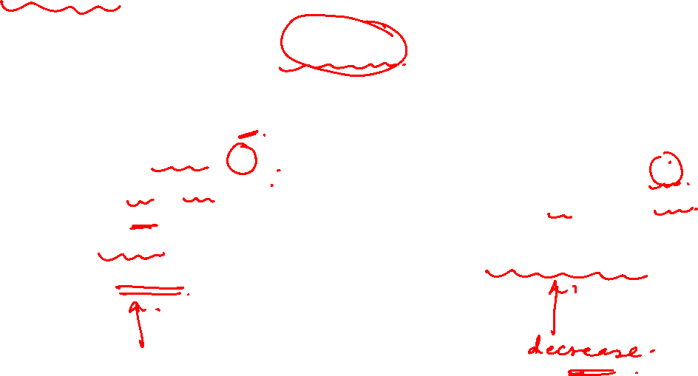
Knife’s edge
$${If R}_{0}=1$$
Slightly increasing p can push $R_{0} to R_{0}>1$
Thereby spreading the epidemic( possible outbreak)
Slightly decreasing p can push $R_{0} to R_{0}<1$
Thereby eliminating the risk of epidemic spread.

Slide 23
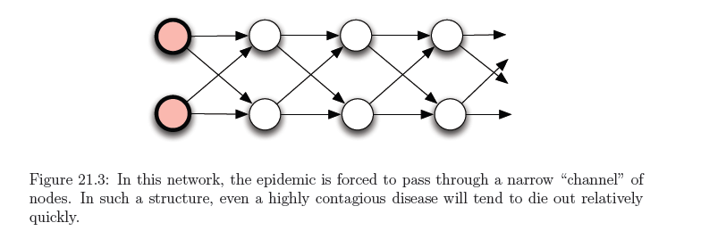
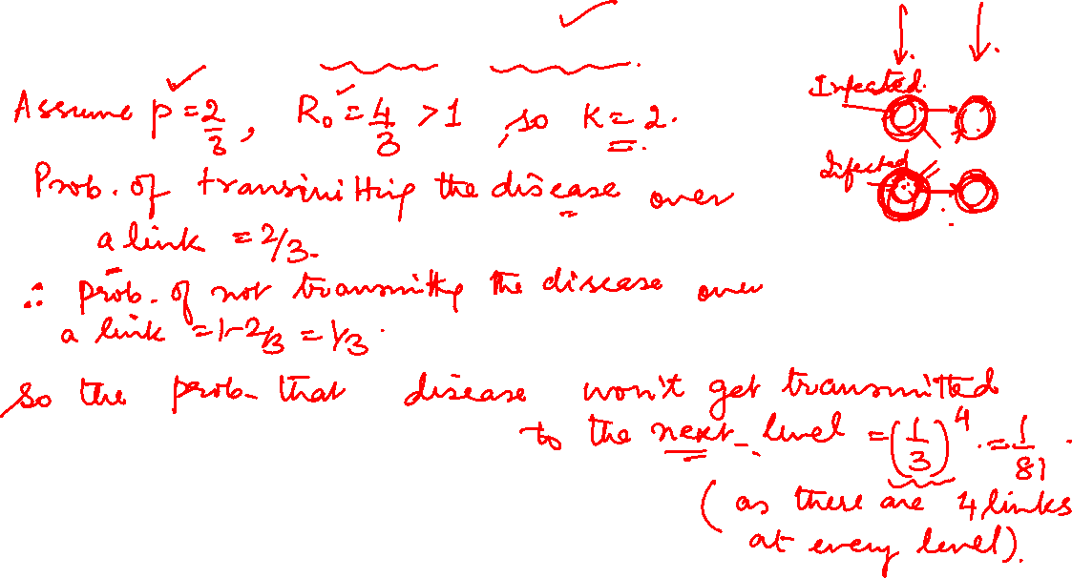
Basic Reproductive Number is not always informative
In this network, the epidemic is forced to pass through a narrow “channel” of nodes. In such a structure, even a highly contagious disease will tend to die out relatively quickly.

Slide 24
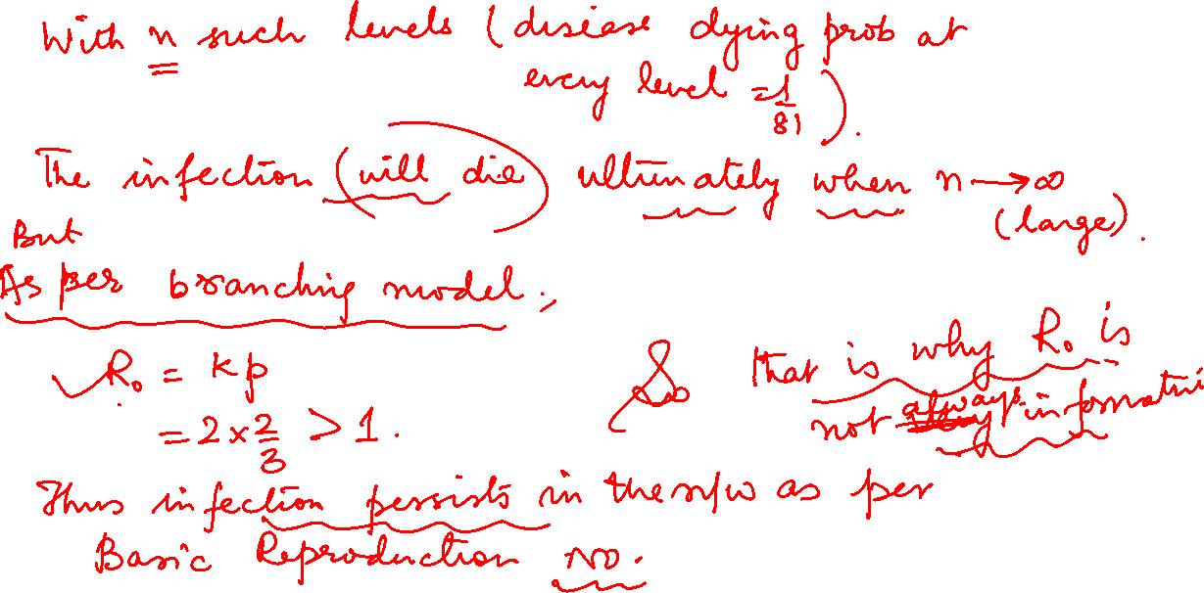

Slide 25
NETWORK ANALYSIS AND MINING
Basic Reproductive Number is not always informative
For R₀ ,the expected number of new cases caused by a single node, assume
p = 2/3, R₀ = 4/3 > 1 since every node has 2 children.
Probability that disease won’t be transmitted on any one link is (1-2/3)= 1/3.
So, probability that disease won’t get transmitted to the next level is : (1/3)⁴ = 1/81 as every level there are 4 links through which they have contacts.
With n such level ( with disease dying probability at every level at 1/81), the disease or infection will ultimately die when n is large
As per the branching model discussion, the infection should persist in the network.
The basic reproductive number is not necessarily informative in the general case

Slide 26
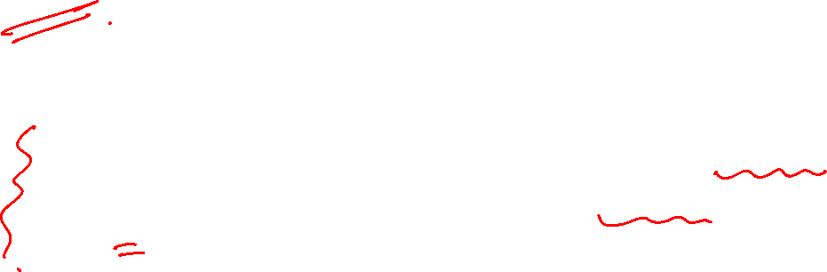
Branching process
For example, in 1918 there was a worldwide outbreak of the swine flu that killed 50 million people.
According to a review article published in BMC Medicine, the R₀ value of the 1918 pandemic was estimated to be between 1.4 and 2.8.
But when the swine flu, or H1N1 virus, came back in 2009, its R₀ value was between 1.4 and 1.6, report researchers in the journal Science.
The existence of vaccines and antiviral drugs made the 2009 outbreak much less deadly.

Slide 27
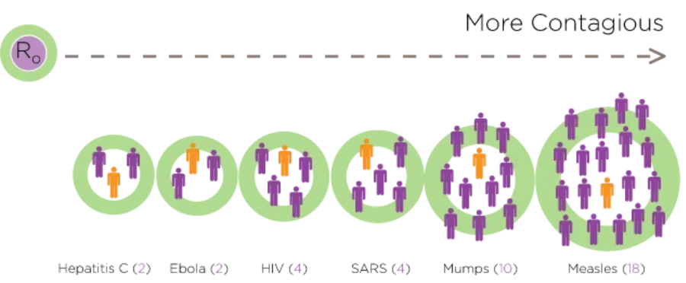
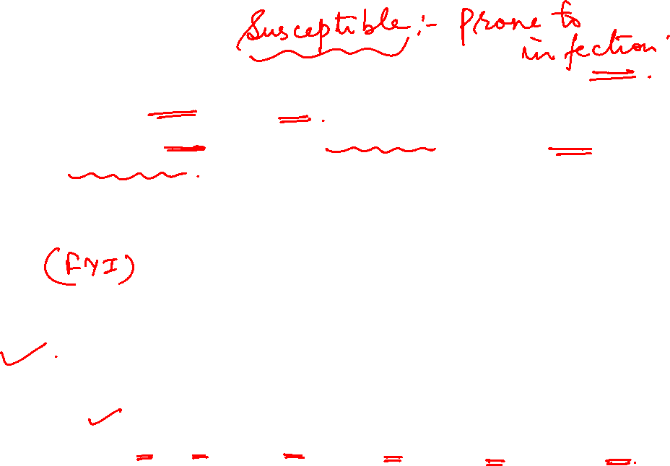
Branching process
What conditions are measured by R₀?
R₀ is a measure to identify any contagious disease that may spread in a susceptible population.
This illustration shows some commonly known diseases and their estimated R₀ values.

Slide 28
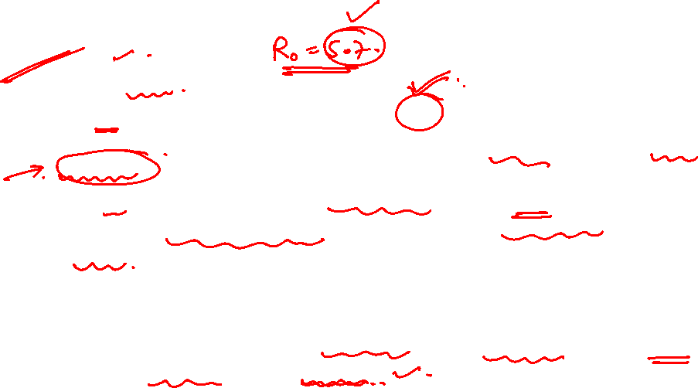
Branching process
COVID-19 R₀
The R₀ for COVID-19 is a median of 5.7, according to a study published online in Emerging Infectious Diseases. That’s about double an earlier R₀ estimate of 2.2 to 2.7
The 5.7 means that one person with COVID-19 can potentially transmit the coronavirus to 5 to 6 people, rather than the 2 to 3 researchers originally thought.
With an R₀ of 5.7, at least 82 percent of the population needs to be immune to COVID-19 to stop its transmission through vaccination and herd immunity.
The researchers estimated a doubling time of 2 to 3 days, which is much faster than earlier estimates of 6 to 7 days.
The doubling time is how long it takes for the number of coronavirus cases, hospitalizations, and deaths to double.
Notes:
Quarantine- a state, period, or place of isolation in which people or animals that have arrived from elsewhere or been exposed to infectious or contagious disease are placed.
"many animals die in quarantine"

Slide 29
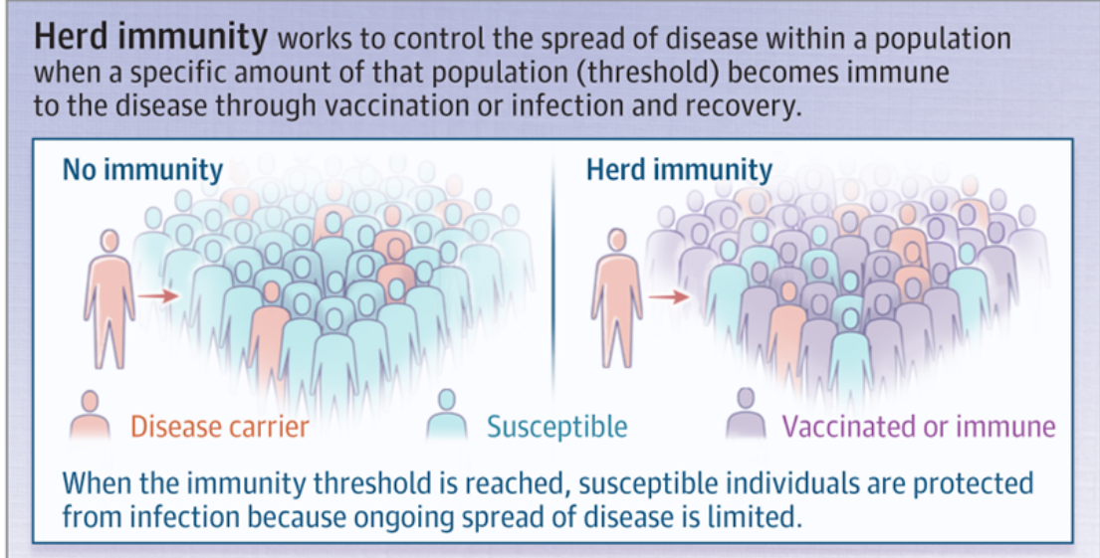
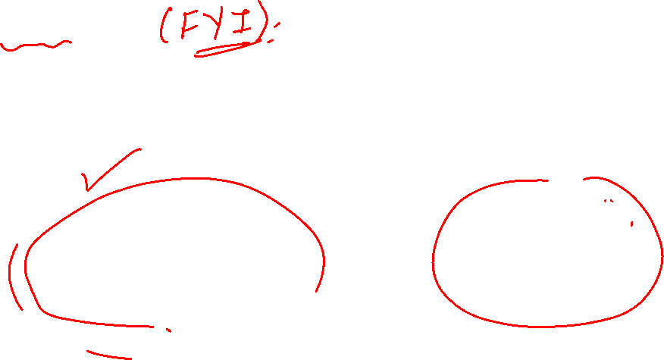
NETWORK ANALYSIS AND MINING
Herd Immunity
Notes:
Quarantine- a state, period, or place of isolation in which people or animals that have arrived from elsewhere or been exposed to infectious or contagious disease are placed.
"many animals die in quarantine"

Slide 30
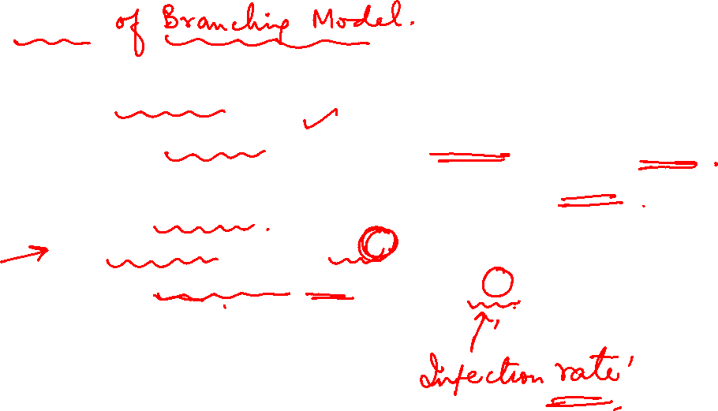
Criticism
Was too simplistic
Assumes no network structure, no triangles or shared neighbors
It is worth investing large amount of effort even to small shift in the basic “reproductive number”
Quarantine people : reduces K
Encourage protective behavior : reduces p

Slide 31
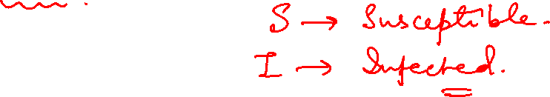
SI model

Slide 32
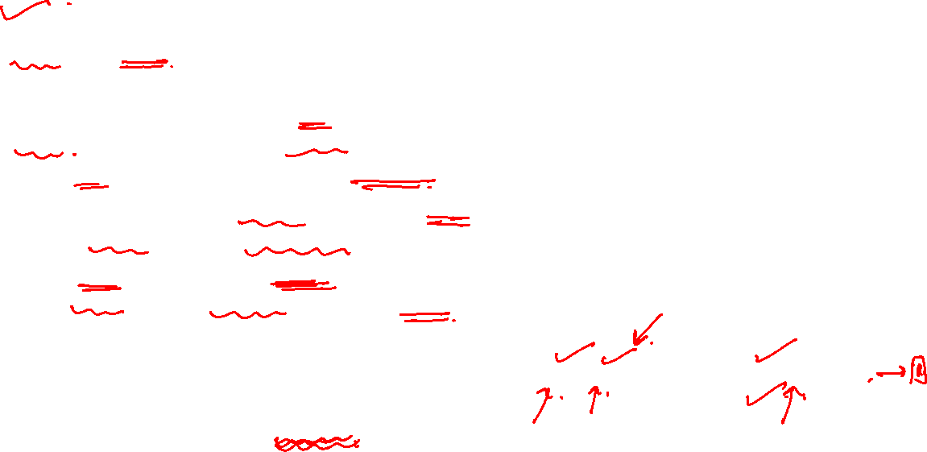
The SI Epidemic Model
The SI model is the simplest form of all disease models. Individuals are born into the simulation with no immunity (susceptible). One way flow
In this model, susceptible individual gets infected and thereafter, they never get cured.
Once infected and with no treatment, individuals stay infected and infectious throughout their life, and remain in contact with the susceptible population.
SI model matches the behavior of diseases like cytomegalovirus (CMV) or herpes.
Susceptible
Infectious
Notes:
https://scipython.com/book/chapter-8-scipy/additional-examples/the-sir-epidemic-model/

Slide 33
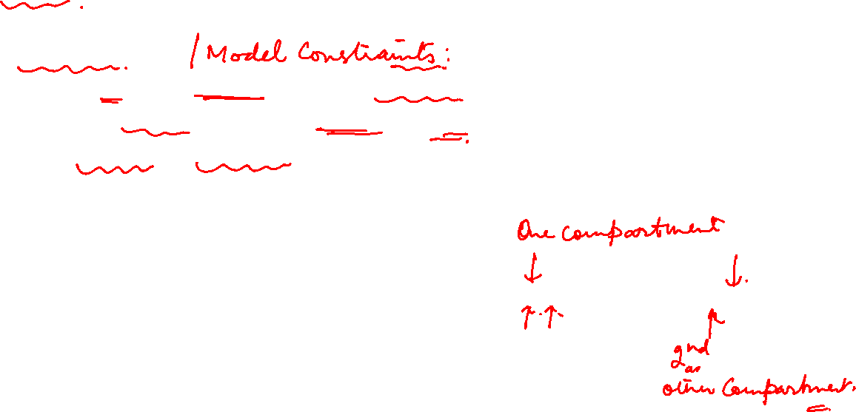
The SI Epidemic Model
Model assumptions:
population can live only in one of the compartments
Total population is fixed ( no entry , no exit )
Fixed rates ( interaction)
Susceptible
Infectious
Notes:
https://scipython.com/book/chapter-8-scipy/additional-examples/the-sir-epidemic-model/

Slide 34

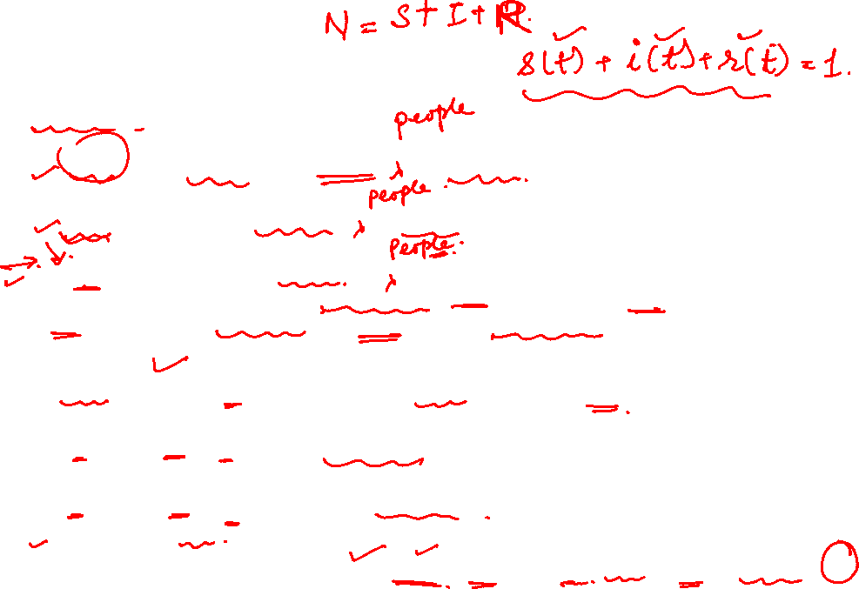
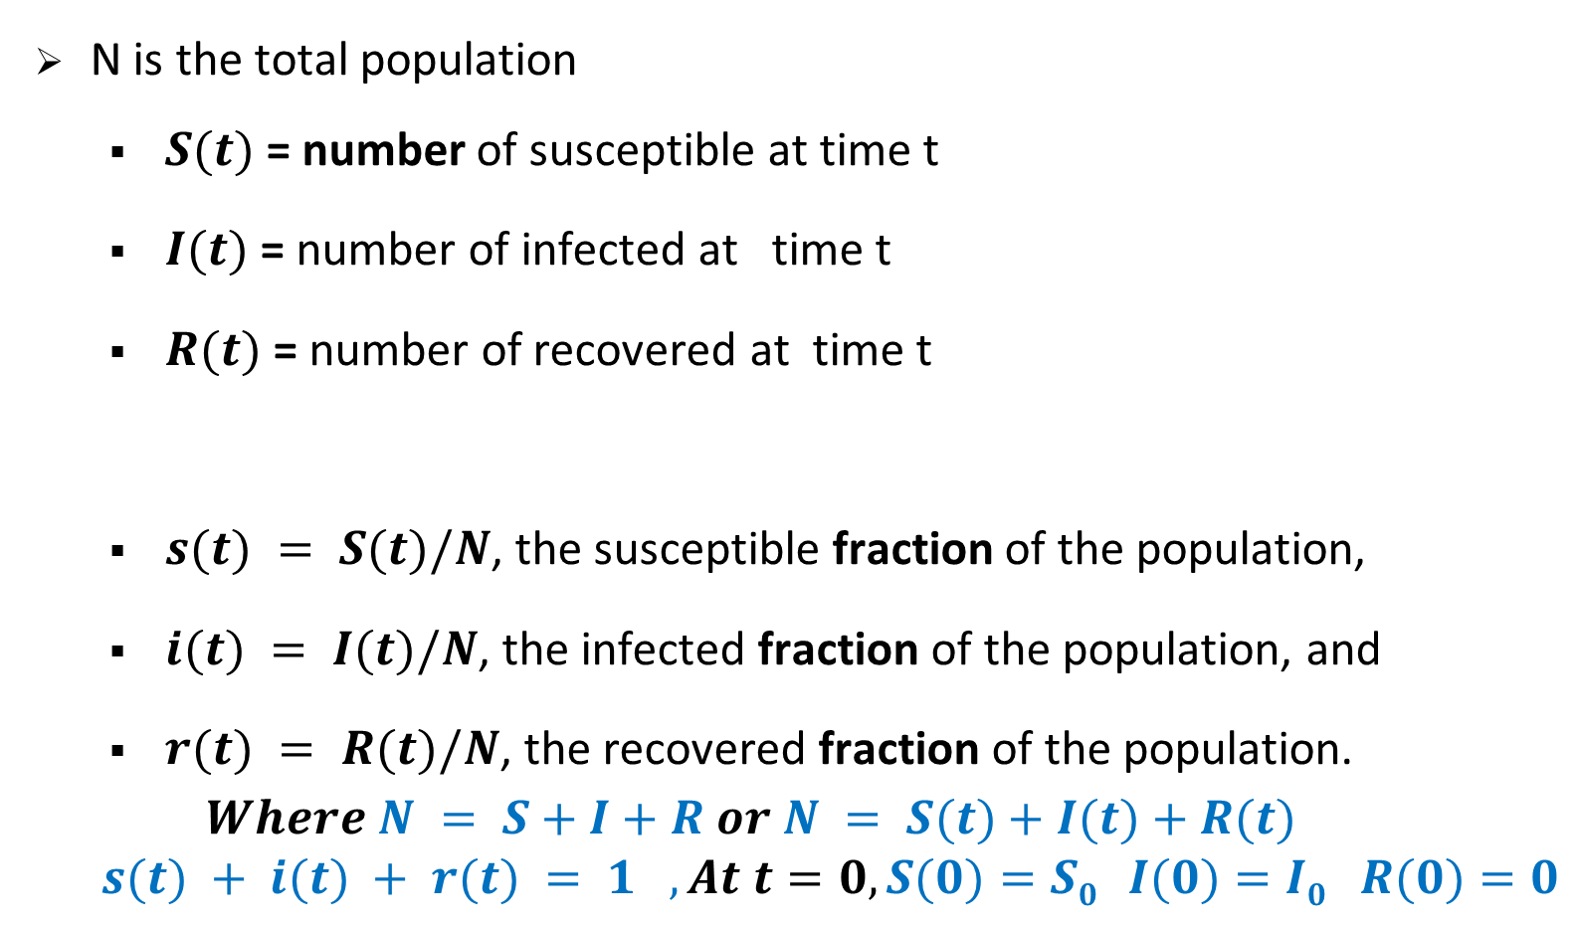
General definitions
N is the total population
$S(t)$= number of susceptible at time t
$I(t)$ = number of infected at time t
$R(t)$= number of recovered at time t
$s(t) = S(t)/N$, the susceptible fraction of the population,
$i(t) = I(t)/N$, the infected fraction of the population, and
$r(t) = R(t)/N$, the recovered fraction of the population.
$$Where N = S+I+R or N = S(t)+I(t)+R(t)$$
$$s(t) + i(t) + r(t) = 1 , At t=0, S(0)=S0 I(0)=I0 R(0)=0$$
These are individuals who have either recovered from the disease and hence have complete or partial immunity against the infection or were killed by the infection.
Notes:
In the beginning, S(0) is more, I(0) is relatively small (may be one) and R(0) is 0.

Slide 35
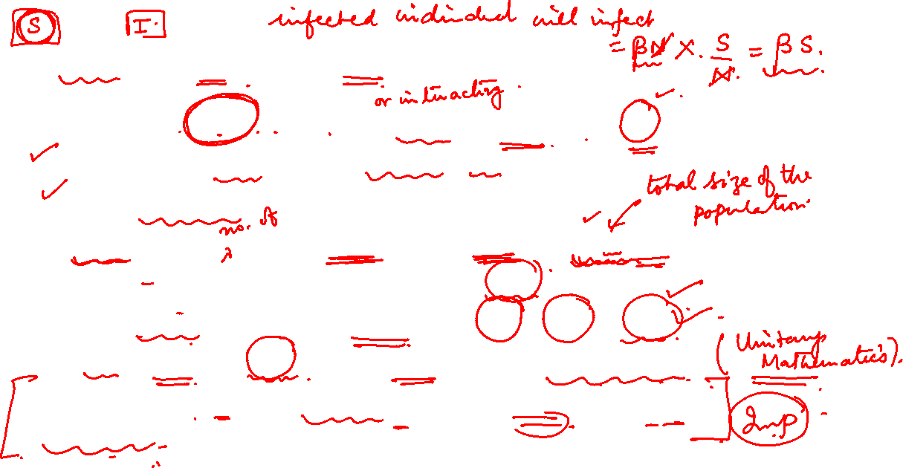
The SI Epidemic Model : Differential Equations
Probability of a pair of people meeting at any time = β
If β= 1 , everybody meets everyone else and
if β=0, no meeting
So, on an average infected individual will meet = βN people.
Since susceptible fraction of population= S/N ,
So, each infected individual will infect = βN * S/N i.e. βS.
Since I are infected, βIS will be infected in the next time step.
Number of susceptible people (S) will be reduced by this factor as well.
Notes:
https://scipython.com/book/chapter-8-scipy/additional-examples/the-sir-epidemic-model/

Slide 36
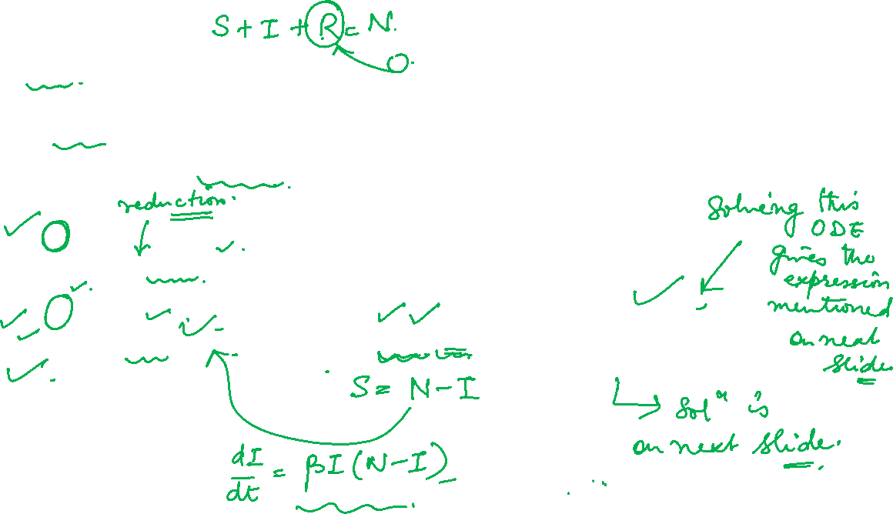
The SI Epidemic Model : Differential Equations
So, SI model can be written as the following ordinary differential equation (ODE)
Since S+I = N , so
Notes:
https://scipython.com/book/chapter-8-scipy/additional-examples/the-sir-epidemic-model/

Slide 37

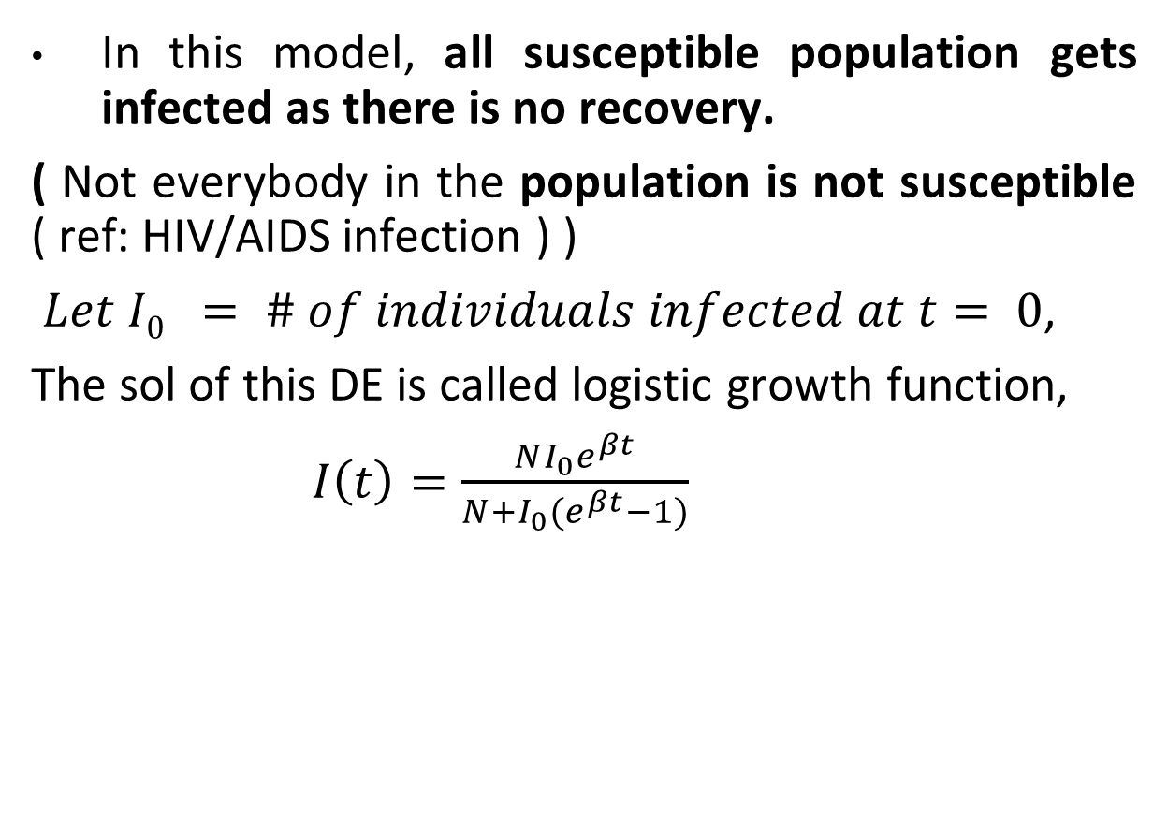
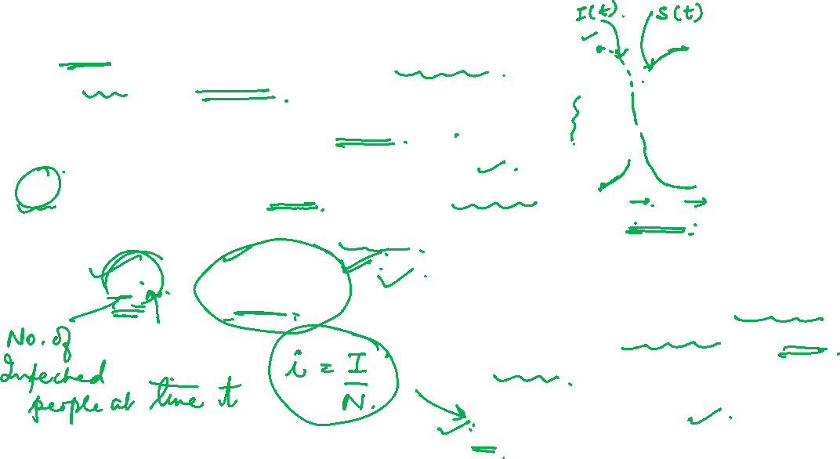
The SI Epidemic Model : Solution to Differential Equations
In this model, all susceptible population gets infected as there is no recovery.
( Not everybody in the population is not susceptible ( ref: HIV/AIDS infection ) )
$Let I0 = \# of individuals infected at t= 0$,
The sol of this DE is called logistic growth function,
$I\left(t\right)=\frac{NI_{0}e^{βt}}{N+I_{0}(e^{βt}−1)}$
“Social Graph” behind Facebook’s valuation
After replacing # of infected individuals by fraction of individuals infected (for better generalization), we get
$$i\left(t\right)=\frac{i_{0}e^{βt}}{1+i_{0}(e^{βt}−1)}$$

Slide 38
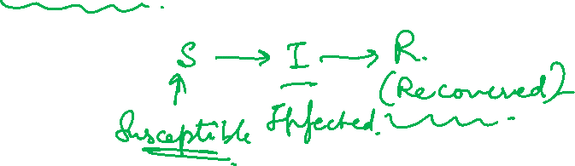
SIR model

Slide 39
SIR model
There is a 3 stage life cycle for each node for disease
Each node may be in the following states
Susceptible: healthy but not immune
Infected: has the virus and can actively propagate it for a given no of time steps
Removed: (Immune or Dead) had the virus but it is no longer active. Once the node goes to this state, it is cured for life.
Parameter p: the probability of an Infected node to infect a Susceptible neighbor

Slide 40
SIR model
Removed individuals are no longer susceptible nor infective for whatever reason; for example, they have recovered from the disease and are now immune, or they have been vaccinated, or they have been isolated from the rest of the population, or perhaps they have died from the disease.

Slide 41
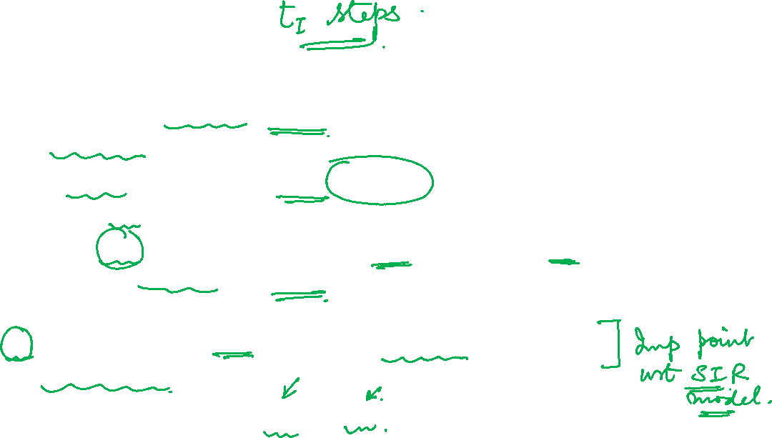

SIR process
Initially all nodes are in state S(usceptible), except for a few nodes in state I(nfected).
An infected node stays infected for $t_{I}$ steps.
Simplest case: $t_{I}=1$
At each of the $t_{I}$ steps the infected node has probability p of infecting any of its susceptible neighbors
p: Infection probability
After $t_{I}$ steps the original Infected node is Removed as it goes to the “recovered” state
Parameters of the model are $t_{I}$ and p

Slide 42

Example with t_{I}=1

Slide 43

Example with t_{I}=1

Slide 44

Example with t_{I}=1

Slide 45
Example with t_{I}=1

Slide 46


SIR epidemic example
Process of epidemic is controlled by
the contact network structure
probability of contagion p
length of infection t₁

Slide 47

SIR and branching process
The branching process is a special case where
the graph is a tree
and the first infected node is the root
The existence of triangles of shared neighbors makes a big difference in SIR general case

Slide 48

The SIR Epidemic Model Specifics
Susceptible -> Infected -> Recovered : only one way flow
Compartmental model – population can live only in one of the compartments
Assumptions :
Total population is fixed ( no entry , no exit )
No reinfection
Recovery total
Fixed rates ( interaction, propensity to infect , recovery)

Slide 49

The SIR Epidemic Model
The SIR model
The second set of dependent variables represents the fraction of the total population in each of the three categories. So, if N is the total population, we have
s(t) = S(t)/N, the susceptible fraction of the population,
i(t) = I(t)/N, the infected fraction of the population, and
r(t) = R(t)/N, the recovered fraction of the population.
Where N = S+I+R or N = S(t)+I(t)+R(t)
s(t) + i(t) + r(t) = 1
At t=0, S(0)=S₀ I(0)=I₀ R(0)=0
Notes:
In the beginning, S(0) is more, I(0) is relatively small (may be one) and R(0) is 0.

Slide 50


SIR Model
γ defines the recovering probability of an infected individual at a time stamp.
γI is the # of people recovered in one time step
“Social Graph” behind Facebook’s valuation
By dividing one equation with the other

Slide 51









SIR model , Solution of Equations ( no need to remember)
By dividing one equation with the other
“Social Graph” behind Facebook’s valuation
($R0 = 0$)
By manipulating between I , S and R
There is no closed form solution for this integration and only numerical approximation is possible.

Slide 52

SIR Model
This model is reasonably predictive for infectious diseases that are transmitted from human to human, and where recovery confers lasting resistance, such as measles, mumps, Influenza, Covid-19, TB, HIV/AIDS and rubella etc..
It has also been used outside of epidemiology, for example in modeling the spread of song popularity, political influence, rumors, gun ownership, and velocity response to traffic congestion.
As implied by the variable function of t, the model is dynamic in that the numbers in each compartment may fluctuate over time.

Slide 53

SIR Model
The model can be used to predict the dynamics of an epidemic, such as the peak number of infections, the duration of the outbreak, and the effects of interventions.
The basic SIR model is deterministic. This means that once the model parameters (β and γ) are specified there is no randomness in the model output.
This is apparent by considering that all transitions between compartments are specified by expected values and not probability distributions.

Slide 54



When Does Infection Curve Flatten ?
Animation of the SIR model with initial values S(0)=997, I(0)=3, R(0)=0 , and rate of recovery $γ=0.04$ . The animation shows the effect of reducing the rate of infection from $β=0.5$ to $β=0.12$ . If there is no medicine or vaccination available, it is only possible to reduce the infection rate (often referred to as "flattening the curve") by appropriate measures such as social distancing.

Slide 55

When Does Infection Curve Flatten ?
Flattening is important as otherwise health infrastructure cannot cope up !
This happens when dI/dt = 0
Recall β = how the infection travels( infection probability or transmission rate)
γ = Recovery rate
At some point infection rate = the recovery rate and beyond that point, recovery overtakes !!

Slide 56

Analyzing SIR Epidemic Model
Susceptible
Infected
Recovered

Slide 57

Analyzing SIR Epidemic Model
Susceptible
Infected
Recovered

Slide 58


The Graphs : SIR Epidemic Model
The SIR model
What happens if initial I = 0?
Answer: Nobody infected so disease can not spread, nobody gets sick
What does it mean that red line increases so rapidly?
Answer: This is a very contagious disease.

Slide 59

The Graphs : SIR Epidemic Model
The SIR model
3. What does it mean that green line also rises rapidly, but not as rapidly?
Answer: People recover quickly, but slower than they become infected.
4. What does it mean that the green line reaches nearly to 1,000?
Answer: Nearly everyone recovers, disease not very deadly.

Slide 60


The SIR Epidemic Model Extension 1
Extend the model to handle more complex assumptions.
Think of, contagion is more likely between certain pairs of nodes by assigning a separate probability p_{v,w} to each pair of nodes v and w for which v links to w in the directed contact network.
If p_{v,w} =high $\overset{⇒}{} closer contact and more likely contagion$
If p_{v,w} =low $\overset{⇒}{} less intensive contact or less likely contagion$.
2. The infectious period can be modeled as random in length.
It can be assumed that an infected node v has a recovery probability q in each step while it is infected, while leaving the other details of the model as they are.

Slide 61

The SIR Epidemic Model Extension 2
More elaborate extensions to the model involve
The I state can thought of as a sequence of several states
Early,
Middle, and
Late periods of the infection, and
allowing the contagion probabilities to vary across these states.
This extension can be used to model a disease with a highly contagious incubation period, followed by a less contagious period while symptoms are being expressed.
SIR model extension is also considered in which the disease-causing pathogen is mutating (and thus changing its disease characteristics) over the course of the outbreak.

Slide 62

Percolation : intuition(static view of the epidemic spreading model)
Just a different view.
Instead of using length of infection T_{I} and going step by step over each T_{I} , we take a static view of the whole process
It is like tossing a coin ( biased with the probability of head as p and probability of tail as 1-p) over every edge in the network.
If head, we establish a pipe on the edge.
Percolation: we have a network of “pipes” which can carry liquids, and they can be either open, or closed
The closed pipes can be pathways within a material
If liquid enters the network from some nodes, does it reach most of the network?
The network percolates through the open pipes

Slide 63

Epidemics and percolation
Open & blocked edges : with all the coins flipped in advance ( for modelling purpose, it does not matter) , the edges in the contact network for which coin flip is successful, are declared open ! Remaining edges are declared blocked
Percolation has been extensively used in physics and Material Science

Slide 64

Percolation process parameter ᴓ
Is a process of collecting some fraction of network nodes with adjacent edges
Parameter : occupation probability (vertex is present) ᴓ
If ᴓ is large, there is a giant component but as ᴓ becomes smaller, then this giant component breaks into smaller components or clusters
The formation or dissolution of giant component like this is called percolation threshold
ᴓ = 1 , all vertices are present
ᴓ = 0 none are present

Slide 65

SIR and Percolation
There is a connection between SIR model and percolation
When a virus is transmitted from u to v, the edge (u, v) is activated with probability p.
Which nodes will be infected?
The nodes reachable (through existing pipes) from the initial infected nodes will get affected
In this way we transform the dynamic SIR process into a static percolation model.

Slide 66
SIR and Percolation
There is a connection between SIR model and percolation
When a virus is transmitted from v to w, the edge (v, w) is activated with probability p.

Slide 67


Percolation (Static View)

Slide 68
SIR and Percolation
Which nodes will be infected?
The nodes reachable (through existing pipes) from the initial infected nodes will get affected
In this way we transformed the dynamic SIR process into a static percolation model.

Slide 69

SIR (Dynamic View)

Slide 70

Percolation (Static View)

Slide 71

The SI and SIR Epidemic Model: Quick Facts
The SI (Susceptible-Infected) model assumes that
Individuals who are infected with a disease do not develop immunity after recovering from the infection, and they can be infected again at any time. Therefore, the SI model does not include any assumptions about immunity.
The SIR (Susceptible-Infectious-Recovered) model assumes that
individuals who recover from the infection develop permanent immunity to the disease and cannot be infected again. However, there are some diseases where the immunity may not be permanent, and individuals can get reinfected after some time. For example, the immunity to the common cold caused by coronaviruses is not permanent, and individuals can get reinfected with a different strain of the virus.

Slide 72
The SI and SIR Epidemic Model: Quick Facts
Overall, the assumptions about immunity in mathematical models of infectious diseases depend on the specific disease being modeled and the available data on the duration and effectiveness of immunity.

Slide 73

SIS model

Slide 74

Susceptible
Infectious
The SIS Epidemic Model
So, far every node was getting infected at most once. But this may not be the case always.
Nodes can get reinfected multiple no of times.
The SIS model
The SIS Epidemic Model is a way of modeling diseases by classifying the population based on their disease status.
2 way flow !
S - The susceptible population who are not affected but are at risk for infection.
I - Infected individuals who are capable of transmitting the disease

Slide 75


SIS model
Susceptible-Infected-Susceptible
Susceptible: healthy but not immune
Infected: has the virus and can actively propagate it
SIS model
Initially some nodes are in S and some are in I
Each node that is in I, can infect a Susceptible neighbor with probability p
After $t_{I}$ steps, the node goes back to Susceptible
The parameters of the model are p and $t_{I}$
A generalization :
An Infected node becomes Susceptible again with probability q ( after $t_{I}$ steps)
In a simplified version of the model t_{I} = 1
The parameters of the model in this case are p,q and $t_{I}$
Nodes alternate between Susceptible and Infected status

Slide 76


SIS example
Node v starts as infected, then recovers (susceptible) and gets infected again
When no Infected nodes, virus dies out
Question: will the virus die out?

Slide 77





SIS Model
The SIS model is the same as the SI model with the addition of infected nodes recovering and becoming susceptible again
“Social Graph” behind Facebook’s valuation

Slide 78


SIS Model
Case 1: When $N≤γ$ (or when $N≤$ $\frac{γ}{β}$ ):
The first term will be at most zero or negative
The whole term becomes negative
In the limit, I(t) will decrease exponentially to zero
Case 2: When $N>γ$(or when $N>\frac{γ}{β}$):
We will have a logistic growth function like the SI model
“Social Graph” behind Facebook’s valuation

Slide 79


SIS Model
S
I
It will reach a steady state where both Susceptible and Infected reach an equilibrium
“Social Graph” behind Facebook’s valuation
SIS model simulated with S₀ = 99, I₀ = 1, β = 0.01, and γ = 0.1

Slide 80

Life cycles of SIR and SIS
SIR model :
The epidemic or spread will eventually die out as the number of nodes are limited in the network and eventually most nodes will be in “recovered” state
The network can be in either of two states after the epidemic has died out
All nodes have recovered ( locked out from scope permanently)
Some nodes have recovered and some are not infected. Those that are not infected, did not get the infection because they did not have an adjacent infected node.
SIS model :
Unlike SIR model, it can keep running for ever as nodes move from infected to susceptible state again
However, there is a finite probability of epidemic stopping in this model ( it depends on the network configuration)

Slide 81

Connections between SIR and SIS
Possible to represent some of the basic variants of SIS as special cases of SIR by thinking of SIS as a sequence of SIR
Key insight is : we think about a node v being a different individual at each time step
For T_{I} =1, for a SIS model, at t=0,1,2,3,.. We create a separate copy of each node and call this a time-expanded contact network
Same SIS Disease dynamics that was circulating through the original contact network can now flow forward in time through time-expanded contact network

Slide 82

SIS modeled as an SIS epidemic on the time-expanded network

Slide 83

SIR vs. SIS
SIR model includes a recovered or immune category,
Individuals who recover from the infection are assumed to be immune to the disease and are transferred to the recovered category.
# of susceptible individuals decreases over time, as more people become infected and then recover and move to the recovered category.
SIR model allows for a natural end to the epidemic, as the number of susceptible individuals decreases to a point where the disease can no longer spread effectively.
SIS model does not have R category
SIS model assumes that individuals who recover from the infection become susceptible again, and can be re-infected with the same disease. Therefore, the number of susceptible individuals remains constant over time.
The SIS model, however, does not have this natural end point, as susceptible individuals can become infected again and continue to spread the disease.
can run for an extremely long time

Slide 84

SIRS model

Slide 85

SIRS model
Initially some states are in I and some in S state
Each node in I , say node v, stays infected for T_{I} steps
During each of the T_{I} steps, it can infect neighbours with probability p
After T_{I} steps, node v is no longer infectious and enters R(emoved) states for T_{R} steps ( during this, it can no longer infect and it cannot be infected)
After T_{R} steps, it goes back to S(useptible) state
Parameters in this model are T_{I} , T_{R} and p

Slide 86



SIRS model
The individuals who have recovered will lose immunity after a certain period of time and will become susceptible again
“Social Graph” behind Facebook’s valuation
Like the SIR, model this model has no closed form solution, so numerical integration can be used

Slide 87


SIRS Model
“Social Graph” behind Facebook’s valuation
SIRS model simulated with S₀ = 99, I₀ = 1, R₀ = 1, β = 0.01, $λ=0.02$, and γ = 0.1

Slide 88

Comparing basic epidemic models
Status
Status
Status in social network
 | SI | SIS | SIR | SIRS
Susceptible |  |  |  |  | An individual will become a communicator
Infected |  |  |  |  | A communicator
Removed |  |  |  |  | Will not spread infection

Slide 89


Epidemic intervention – mad cow disease
Jan. 2001
First case observed in UK
Feb. 2001
43 farms infected
Sep. 2001
9000 farms infected
The disease is caused by prions, which are abnormal proteins that can cause other proteins to fold abnormally and lead to brain damage.

Slide 90
Epidemic intervention : network
In any epidemic outbreak, infected individuals infect susceptible individuals.
A well-connected infected individual is more dangerous to the epidemic outbreak than someone who has no contacts. In other words, the epidemic takes place in a network.
The best way to intervene with the epidemic outbreak would be to vaccinate the highly connected nodes and stop the epidemic. This would result in what is known as herd immunity and would stop the epidemic outbreak.
Older intervention techniques such as separating those infected from those susceptible (quarantining them) or removing those infected (killing cows with mad cow disease) still work.

Slide 91
Epidemic intervention : network
In the mad-cow disease case, we have weak ties,
Animals being bought and sold
Soil from tourists, etc.
To protect:
Make contagion harder ( p)
Remove weak ties (e.g., mad cows) ( K)

Slide 92

Epidemic Intervention
In the case of MCD, weak ties can refer to various connections between individuals and groups involved in the production, distribution, and consumption of cow products. For example:
Animals being bought and sold: The movement of animals between farms and markets can create opportunities for the spread of MCD. Weak ties between different farmers and traders may lead to inadequate testing or monitoring of animals, increasing the risk of infected animals entering the food chain.
Soil from tourists: The soil that tourists bring into a country can contain prions, which can contaminate crops and feed. Weak ties between tourists and local farmers or traders may lead to insufficient awareness of the risks of soil contamination and inadequate measures to prevent it.
MCD usually takes four to six years from the time a cow is infected with the abnormal prion to when it first shows symptoms of BSE. This is called the incubation period.

Slide 93

Global dynamics of a disease and epidemic model
Look at the issue of global dynamics of a disease – tendency of certain disease to synchronize across a population producing string of oscillation in the number of affected individuals
SIRS can happen in waves. There are some factors which lead to R nodes becoming S after a long pause of all nodes resting in R state. These nodes finally go to I again
Example – cycles in syphilis prevalence across USA is attributed to large scale societal changes
SIRS model helps simulate oscillation by providing temporary but not permanent immunity

Slide 94

Synchronization, oscillation, small world network and epidemic models
Temporary immunity can produce oscillations ( patches of immunity with large number of infections in a concentrated area.) in localized part of network
Natural mechanism to produce this kind of coordination is a network that is rich in long range connections i.e. weak ties that link different parts of network lead to flare ups
Watts and Strogatz observed the relevance of small world properties to synchronizations. Kuperman and Abramson showed that it will lead to synchronization and oscillation in epidemics.

Slide 95

Synchronization, oscillation, small world network and epidemic models
4. In small world model, the probability of rewiring is say, c. If SIRS model is run on such a network with various values of c
Small c leads to flareups in one part of network but never coordinated with other parts
Large c leads to synchronization of flare ups across network and due to temporary immunity in SIRS, we also see a wave structure of flareups that flow across the network
5. Epidemic data is observed for syphilis and gonorrhea in USA where syphilis offers temporary immunity like SIRS but gonorrhea does not. Timing of syphilis cycle fits well with the timing of immune properties associated with it and there is a synchronization observed

Slide 96


Synchronization, oscillation, small world network and epidemic models
SIRS epidemics in networks with different proportions of long-range links.
With c representing the fraction of long-range links, we see an absence of oscillations for small c (c = 0.01), wide oscillations for large c (c = 0.9), and a transitional region (c = 0.2) where oscillations intermittently appear and then disappear. (Results and image from [267].)
depict the number of infected people over time

Slide 97

NETWORK ANALYSIS AND MINING
When a highly contagious disease may die out ?
In general it is proven that in random networks ( which are NOT real social networks), epidemics do not spread so much and mostly die out. But this is not of any real significance for the practical networks
Many real networks are scale free networks and a major feature of the scale free networks are hubs which are few nodes with very large degree. The hubs in scale free networks, if infected, becomes the super spreader and beyond that epidemic spreads really first. However, the real challenge is to identify the hubs. Once the hubs are protected, even a highly contagious disease will not spread
Small world networks which has small average path length because of weak links also spreads contagious diseases easily. The prevention of contagion strategy has been to remove the weak links in the network in case of an epidemics i.e. remove weak cows in mad cow disease or culling of birds in birdflu

Slide 98
THANK YOU
Dr. Arti Arya
Department of Computer Science and Engineering

